Slide 1
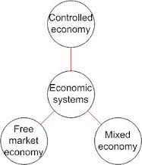
Economic Systems
How the Government influences how I make money.

Slide 2
All Economic Systems Must Consider the Following Questions:
What goods and services to produce?
How will they produce them?
Who will get them?
How much will they produce now, and how much later?
Each economic system answers these questions in a DIFFERENT WAY.

Slide 3
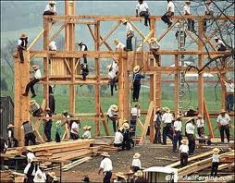
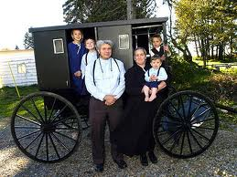
Traditional Economy
Economic questions are answered by habits and customs (the way it has always been done)
Children work the same jobs parents worked, often farming or hunter/gatherer
Fear Change!
Ex. Eskimos, the Amish,
Pigmies, Bush People

Slide 4
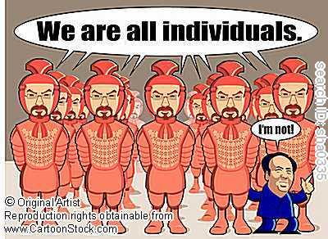
Communist
The rich get richer.
The poor get poorer.
People wanted to make everything equal.
Lack of individuality
Lack of choice
Equal treatment for all, even if you work harder than all the rest

Slide 5
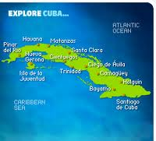
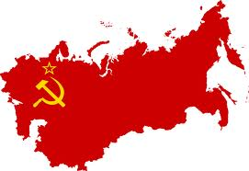
Command Economy
The government answers the basic economic questions
Advantages: able to act quickly in emergencies, provide for all people equally
Disadvantages: Inefficient, no incentive to work hard or be creative
Ex. Communist Countries (China, Vietnam, North Korea, former
Soviet Union, Cuba)

Slide 6
Socialist
Government ownership and administration of the means of production and distribution of goods
A system of society or group living in which there is not private property
A system or condition of society in which the means of production are owned and controlled by the state

Slide 7
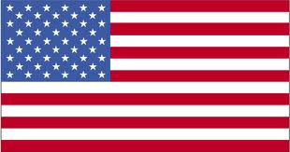
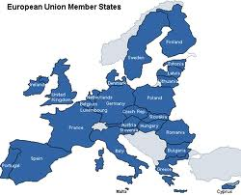
Free Market Economy
Economic questions are answered by individual buyers and sellers.
Supply and demand influence economy
People act out of self interest; motive for profit (money) drives the economy
Also known as FREE ENTERPRISE or CAPITALISM
Ex. The United States, Western
Europe, Japan

Slide 8
I lied!
I said there were 5 types of economic systems, but there is a 6th!
Mixed Economy: No economy is pure market, pure command or pure traditional, elements of each appear in all economies, some have more elements of one economy than another.
Market Mixed Command
USA Great Britain China

Slide 9
American Mixed Economy
While the United States is mostly a free market economy, it does have elements of a command economy.

Slide 10
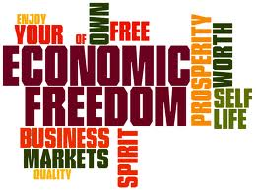
Features of American Free Market Economy
Economic Freedom: individuals have the right to choose
Competition: more than one producer of good/services insures choice
Private Property: individuals have the right to own their own property, including business

Slide 11
Features of American Free Market Economy (cont)
Self-Interest: individuals make
decisions based on what is best for them
Voluntary Exchange: individuals may freely buy and sell goods
Profit Motive: individuals are driven by a desire to profit (make money)

Slide 12
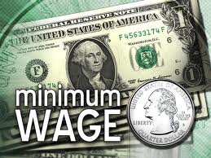
Features of American Command Economy
Government regulation of some business practices
Ex. Wages, labor hours,
safety practice.
Government limits certain choices
Ex. Cannot buy or produce certain goods/services
Government provides aid to the needy
Ex. Medicare, Medicaid, welfare

Slide 13
My Pizzeria
How would my pizzeria function under different economic systems?

Slide 14
My Pizzeria in a Free Market
I answer the basic economic questions!
I determine how much cheese and pepperoni goes on the pizza
I determine the quality of the cheese and pepperoni
I set my employees wages
I set my business hours

Slide 15
My Pizzeria in a Command Economy
The government answers the basic economic questions
The government sets the amount of cheese and pepperoni on each pizza
The government determines quality of cheese and pepperoni
The government sets employees wages
The government sets business hours
Problem: What does the government know about pizza?

Slide 16
My Pizzeria in a Mixed Economy
The Government and I both answer the basic economic questions
I determine the amount of cheese and pepperoni on the pizzas; government determines the quality of cheese and pizza
I set employee wages; government sets minimum wage for employees
I determine business hours; government determines whether I am safe to be open or not

Slide 17
1.
State planners in Country A met to decide what the country should focus on producing. After much deliberation, they decided it would be in the country’s best interest to use their limited resources to produce automobiles instead of other consumer goods, such as electronics or textiles. The state planners passed their decision down to factories, and allocated to them raw materials, workers, and other resources needed to produce automobiles. Factories were then told how much they should produce with these resources and who the final products should be shipped to.
Notes:
Answer: Command economy
How do you know?: State planners decide what to produce, how to produce it, who it should be produced for.

Slide 18
2.
In Country B, business owners decide what to produce, how much to produce, and who to produce for. The CEO of Tarheelia Audio, one of the leading audio equipment producers in the country, recently decided to increase production levels of the company’s newest MP3 player model, and at the same time decrease production levels of their most popular CD player. The reason for the emphasis on MP3 players is that demand for CD players has decreased dramatically as MP3 technology has taken over the market. Simply put, there is more profit to be made in the MP3 market.
Notes:
Answer: Market economy (could also be mixed, if it is assumed that government regulates industry)
How do you know?: Individuals make economic decisions; decisions made based on demand; profit motivation

Slide 19
3.
In Country C, people rarely engage in market transactions. For the most part, they do not need to. Families grow their own vegetables and raise their own animals or hunt to get meat. Certain times get tough for people in Country C, like when the winters are particularly cold or animals change their migration patterns. For this reason, it is important that families stock up in “good times” and develop relationships with neighbors with whom they can share or trade.
Notes:
Answer: Traditional economy
How do you know?: Economic activities centered around family; resources are determined by environment

Slide 20
4.
In Country D, business owners make most economic decisions. As long as they abide by fair trade policies, they can decide what to produce, how to produce, and for whom to produce without government intervention. These decisions are made by business owners based on what happens in the market. For example, a computer manufacturer recently developed a new video gaming system, but decided to wait until closer to the holidays to release the system to the public because it believed anticipation among consumers would allow the company to charge a higher price for the system
Notes:
Answer: Mixed economy
How do you know?: Business owners make economic decisions, but government can intervene

